Slide 1
DBS Day 2
John Cabibbo
jcabibbo@fullsail.com
AIM: jcabibbo@fullsail.com

Slide 2
Day Overview
Screen Casts
Review Day 1 & Lab 1
Backups
Architecture / Clusters
Comparisons
Limit
SQL Standard Functions
Table Prefix
Aliasing Columns
Joins: Cross Join, Inner, Outer
Constraints
Natural vs Surrogate Keys
Foreign Keys
Types of Relationships: 1-1, 1-n, n-n
Indexes
ER Diagram

Slide 3
GitHub
Sign up / Install GitHub
Give your instructor your username.
You will be invited to collaborate in a repo.
Johncabibbo/dbs
Under homework is your directory (first initial lastname). Submit your labs in sub-directories (lab1, lab2 …)
You will be submitting ALL of your labs to this repo.
Submit screen casts as a link to YouTube or other video hosting site.

Slide 4
Review
Types of Databases
Data Types (Char, varchar, Int, tinyInt, bit)
Constraints - Primary & Foreign
Relationships
Select, Insert, Update, Delete
Backups - SQL Dump

Slide 5
Export / Backup
MySQL Dump
Backups to a SQL file
Raw Backup
Your DB must be shutdown
Copy you files from Applications/MAMP/mysql/databaseName
Hot Backups
Pros: Database can remain up
Cons: Performance Impact

Slide 6
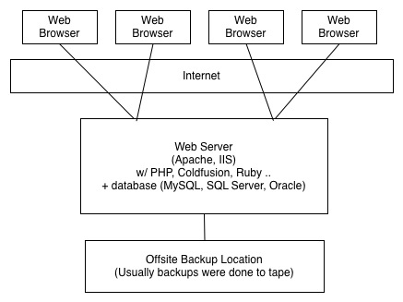
Architecture
Circa 1997

Slide 7
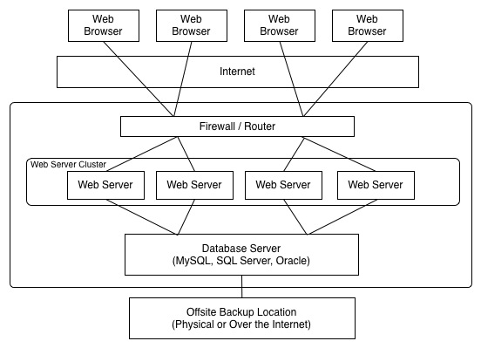
Architecture

Slide 8
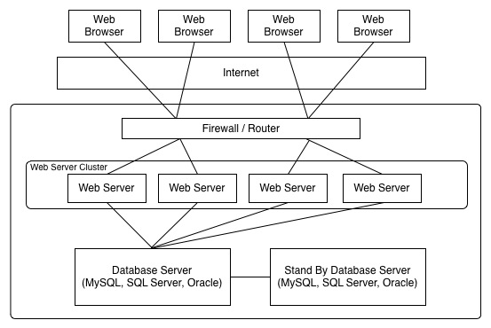
Architecture

Slide 9
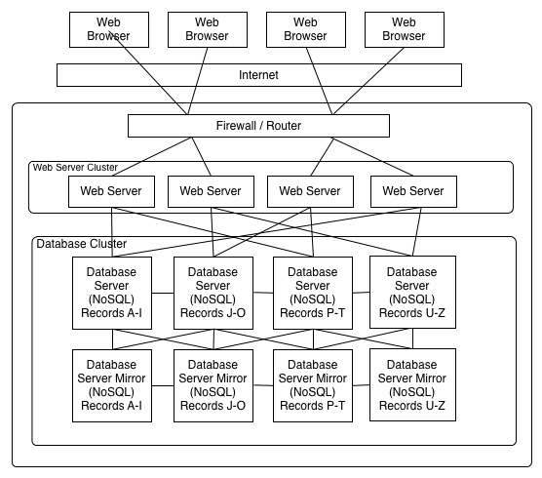
Architecture

Slide 10
Comparisons
=
!= or <>
<
>
<=
>=
like
In
between

Slide 11
Limit
Select firstname, lastname
from users
limit 100;

Slide 12
Functions: count
Select count(*) from activityLog;
Select count(orderId) from activityLog;
Count(*) and count(col) are not the same.
Count(*) is the count to rows.
Count(col) is the count of rows where the col is not null

Slide 13
Functions: concat
Concat: Concatenates strings together.
select concat(firstname,' ',lastname)
from users
limit 100;

Slide 14
Table Prefix
select userId, lastname, userEmail
from users
join userEmail on users.userId = userEmail.userEmailId;
This causes an error because the database cannot determine which user column should be returned.

Slide 15
Table Prefix
Preface the column with the table name.
select users.userId, lastname, userEmail
from users
join userEmail on users.userId = userEmail.userEmailId;

Slide 16
Aliasing Columns
select firstname as fn, lastname as ln
from users
limit 100;
select concat(firstname,' ',lastname) as fullname
from users
limit 100;

Slide 17
Alias Tables or Columns
select users.userId, firstname, lastname, userEmail
from users
join userEmail on users.userId = userEmail.userEmailId;
select u.userId, firstname, lastname, userEmail
from users u
join userEmail ue on u.userId = ue.userEmailId;

Slide 18
Joins
Users
UserEmail
UserEmailType

Slide 19
Cross Join
Also called a cartesian product.
SELECT *
FROM users
JOIN userEmail;
You may need to use the LIMIT command.

Slide 20
Joins
SELECT *
FROM users
JOIN userEmail
ON userEmail.userId = users.userId
What record set is returned?
http://www.w3schools.com/sql/
http://dev.mysql.com/doc/refman/5.1/en/join.html

Slide 21
Joins
SELECT *
FROM users
JOIN userEmail
ON userEmail.userId = users.userId
JOIN userEmailType
ON userEmailType.userEmailTypeId = userEmail.userEmailTypeId
What record set is returned?

Slide 22
Inner Join
The INNER JOIN keyword return rows when there is at least one match in both tables.
select firstname, lastname, userEmail
from users
inner join userEmail
on userEmail.userId = users.userId

Slide 23
Left & Right Outer Joins
The LEFT JOIN keyword returns all rows from the left table (table_name1), even if there are no matches in the right table (table_name2).
select firstname, lastname, userEmail
from users
left join userEmail
on userEmail.userId = users.userId

Slide 24
Left & Right Outer Joins
The RIGHT JOIN keyword returns all the rows from the right table (table_name2), even if there are no matches in the left table (table_name1).
select firstname, lastname, userEmail
from userEmail
right join users
on users.userId = userEmail.userId

Slide 25


Slide 26
Constraints
PRIMARY KEY
FOREIGN KEY (Null Exception)
NOT NULL
UNIQUE
DEFAULT
CHECK – Not in MySQL

Slide 27
Foreign Key Null Exception
Foreign Keys enforce values but allow for Nulls.
ALTER TABLE activityLog
ADD FOREIGN KEY (orderId)
REFERENCES orders(orderId);
ALTER TABLE activityLog
ADD FOREIGN KEY (userId)
REFERENCES users(userId);

Slide 28
Constraints - Check
The CHECK constraint is used to limit the value range that can be placed in a column.
CREATE TABLE Persons ( personId int NOT NULL, LastName varchar(255) NOT NULL, FirstName varchar(255), Address varchar(255), age int, CHECK (age>21) ) ENGINE=INNODB;

Slide 29
Keys
Primary Key
Foreign Key
Either way, a key can be a single column or a composite key of multiple columns. It can be an integer, a varchar or a char.

Slide 30
Primary Key
“What makes this record unique?” “How do I get/change this one thing?”
Natural Keys Some combination of real data that makes a primary key
firstInitial+lastName+DOB
Surrogate Keys Artificial data added to the record for uniqueness
Autoincrement “id” - Identity, GUID, UUID

Slide 31
Natural / Surrogate Keys
A surrogate key is a row identifier that has no connection to the data attributes in the row but simply makes the whole row unique.
It is unique. It does *NOT* have any reason to change. (Incremental Numeric Value)
Natural Key - A natural key is a row identifier composed of data that uniquely describes data using its own attributes. An example of a natural key is social security number or other government issued number.

Slide 32
Natural / Surrogate Keys
artistID | artistName
6 | Shakira
8 | Madonna
11 | Britney Spears
Surrogate
releaseDate | albumTitle
2001-11-13 | Laundry Service
1998-03-03 | Ray Of Light
Natural

Slide 33
Composite Key
releaseDate | artistID | albumTitle
2001-11-13 | 6 | Laundry Service
1998-03-03 | 8 | Ray Of Light
2009-11-08 | 27 | The Fame Monster
2008-11-28 | 11 | Circus
Composite
Natural
Surrogate

Slide 34
Relationships

Slide 35
Relationships

Slide 36
Relationships
When a foreign key points to the primary key of another table a relationship is formed.
Types of Relationships:
One to one
One to many
Many to many

Slide 37
Indexes
Indexes are used by the DB to enhance performance & enforce constraints.
Indexes may be composed of 1 or more columns.
More indexes may result in better select performance but may increase insert and update overhead

Slide 38
Indexes
A way to quickly find records with a specific value
“The people in ASL are Alice, Bob, and Chris”
Alternative: Scan through the whole table, looking at every row
Can also be simple or composite
Can be unique (like PKs), or not (like FKs)

Slide 39
Indexes
Searching by an index instead of the entire table is more efficient.

Slide 40
ER Diagram
Create an ER Diagram using MySQL Workbench.
Click database, reverse engineer. Follow the directions. Be sure to select the exampleXXX database.

Slide 41
Lab 2
CRUD
Inner & Outer Joins
Alter Table
Foreign Keys
Indexes
ER Diagrams

